Slide 1


Online used books selling
Notes:
NOTE:
To change the image on this slide, select the picture and delete it. Then click the Pictures icon in the placeholder to insert your own image.

Slide 2
Under the supervision of - Ms. Komal Salgotra
Name - Shivanshu Panwar
Roll No. – 2200290140148
Semester - III
Section - C
Session – 2023-24

Slide 3
Introduction
The Online Used Books Selling Project is an innovative e-commerce platform designed to facilitate the buying and selling of pre-owned books. This project aims to provide a user-friendly and efficient marketplace for book enthusiasts to connect, trade, and explore a vast collection of used books. The platform offers a seamless and secure online experience for both buyers and sellers, making it easier for individuals to access affordable books.

Slide 4
Technologies Used
1. Front End Development :
• HTML
• CSS
• Javascript
• BootStrap
2. Back-End Development:
• Java
• JDBC
• Servlet
3. Database
• MySql

Slide 5
Hardware Requirements
Laptop Specification or PC :
1. Windows 8 or Higher
2. i3 processor system or more
3. 4 GB Ram or Higher
4. 50 GB SSD

Slide 6
Modules
1. Admin :
• Add New Books.
• View Books Available.
• Remove Books.
• Increase Books Amount.

Slide 7
Modules
2. User :
• Create New Account or Register.
• Login.
• View Available Books.
• Select Books to Buy.
• Select Books Quantity.
• Buy Books.

Slide 8

Outputs
1. Impact on Environment :
Contributing to sustainability by promoting the reuse of books rather than their disposal.
2. Community Engagement :
Building a community of book enthusiasts and loyal customers.

Slide 9
Conclusion
1. We take pride in our role in promoting sustainability by giving new life to pre-owned books, reducing waste, and encouraging responsible consumption. Our contribution to environmental conservation aligns with our values.
2. We have successfully cultivated a community of book enthusiasts who share our passion for literature. Engaging with our customers and fellow book lovers has been a rewarding aspect of this project.

Slide 10
How to Serve the Society
1. Promote Sustainability :
Emphasize the eco-friendly aspect of used books by promoting sustainability.
Highlight the environmental benefits of reusing books rather than purchasing new
ones.
2. Book Recycling Programs :
Encourage customers to recycle their old books by offering buyback program.
This reduces the number of books discarded and helps books find new homes.

Slide 11
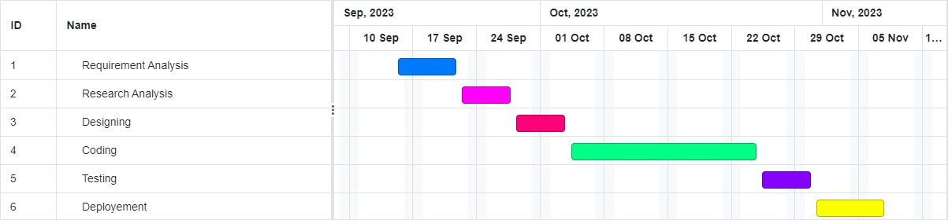
Gantt Chart

